Slide 1
Twitch ETL solution

Slide 2
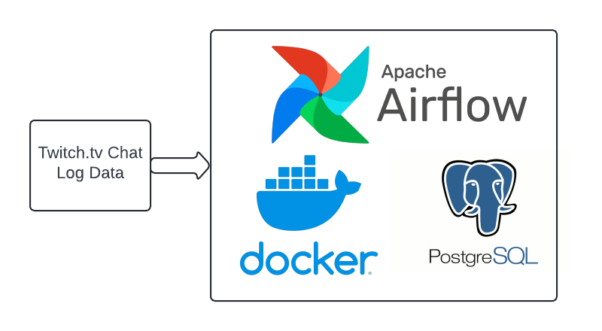
Solution architecture

Slide 3
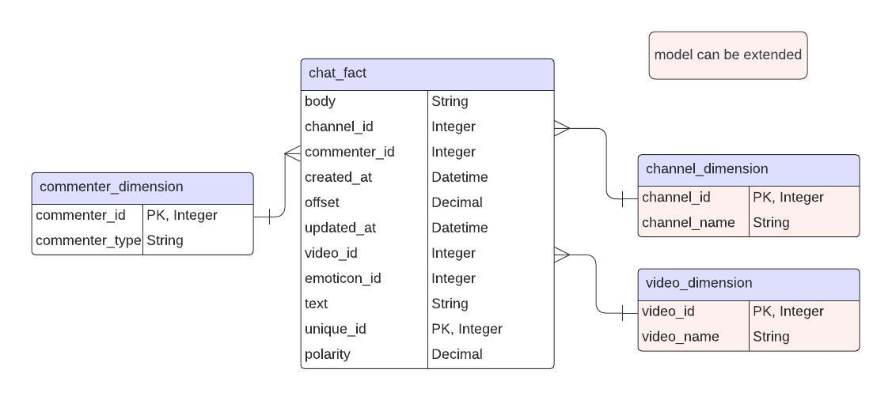
Solution data model

Slide 4
Solution insights
The tool can be used to generate various insights:
For streamers:
Identify the most popular streamers and where each streamer stands -> this will help attract sponsors for popular streamers
Which streams generate the most chats-> this will help streamers concentrate on content that users like, potentially also generating more sponsor money
Identify during which hours streams are most popular -> this will help choose the right time to stream
Identify emotions of the audience -> this will help streamers know how their streams are received, so that they can optimize for positive emotions, for example

Slide 5
Solution insights
The tool can be used to generate various insights:
For audience of streamers:
Identify streams most watched by the audience -> this will help audience members find new potentially interesting streams
Identify days / times of day when most chats happen –> this will help members participate in most lively discussions

Slide 6
Upcoming features
Going forward, the following could be implemented:
Visualization report based on streaming behavior of streamers
Changing data loading to be ‘upsert’ to keep old data and load new one

